Slide 1


Slide 2
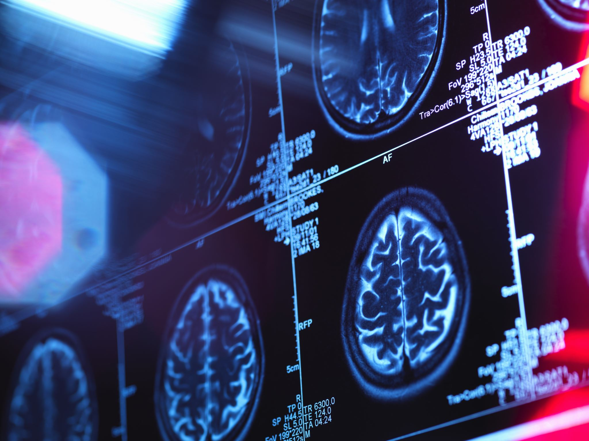
AI FOR MEDICAL DIAGNOSIS(IMAGE CLASSIFICATION)
PRESENTED BY:
HUZAIFA SHAHBAZ(21-CE-009)
PRESENTED TO:
MAAM HAREEM KHAN

Slide 3

OUTLINES
ABSTRACT
INTRODUCTION
METHODOLOGY
HISTORY OF MEDICAL DIAGNOSIS
RECENT TRENDS AND FUTURE OUTLOOK
RESULTS
CONCLUSION
REFERNCES

Slide 4
ABSTRACT
AI is revolutionizing medical diagnostics by utilizing image classification techniques that analyze intricate and delicate medical images using advanced algorithms such as deep learning and machine learning.
AI has demonstrated exceptional accuracy in identifying cancer and other diseases, sometimes even matching or surpassing the level of expertise possessed by humans.
The integration of AI into imaging technology enhances accuracy, minimizes human error, and expedites the diagnostic process, ultimately benefiting patient outcomes.
There are advanced models for highly accurate identification of mammograms and skin cancer in dermatological images.
Nevertheless, there are still obstacles that hinder the widespread implementation of AI in clinical settings: the difficulty in understanding AI decisions, concerns about data privacy, and the requirement for large, high-quality datasets.

Slide 5
INTRODUCTION
Deep learning algorithms, specifically convolutional neural networks (CNNs), are employed to extract and learn important features from images
Reduces the workload on radiologists and pathologists for interpretation
AI systems possess the capability to identify even the most subtle patterns, thereby enhancing the accuracy of diagnoses and early detection of diseases
AI has revolutionized medical diagnostics, enabling precise, speedy, and early identification of diseases. Image classification - a branch of artificial intelligence - involves extracting meaning from various medical imaging modalities.

Slide 6

PROBLEM STATEMENT
Over the past few years, technology has revolutionized the way we interact, perform our jobs, and engage in leisure activities.
The advent of smartphones and social media has revolutionized communication, making it possible for us to have constant connectivity through battery-powered apps that are conveniently located in our pockets.
Furthermore, remote work and virtual meetings have become increasingly prevalent, offering alternative methods for collaboration.
As technology continues to advance, society will experience both positive and negative impacts, along with new challenges and improvements.

Slide 7
OBJECTIVES
Analyze the latest advancements in artificial intelligence (AI) techniques for medical image classification, including the detection of tumors, fractures, and other anomalies in radiographs, CT scans, and MRIs, while also addressing their limitations.
Convolutional neural networks (CNNs) and other deep learning architectures are employed to recognize the essential characteristics in a medical image and patterns that will result in highly precise diagnostic results.
Develop an AI-powered image classification model that efficiently and accurately classifies medical images into specific diagnostic categories.
The research evaluates the effectiveness of different deep learning models, such as residual network (ResNet), visual geometry group (VGG), DenseNet, and inception, to identify the most suitable architecture for practical use in clinical settings.
The study investigates the ethical, regulatory, and clinical considerations of integrating artificial intelligence (ai)-based image classification tools into diagnostic workflows, with a focus on ensuring transparency, explainability, and patient safety.

Slide 8
METHODOLOGY
The process of using artificial intelligence in medical diagnosis through image classification includes:
Collecting data
Preprocessing it
Annotating it
Selecting a model
Training and validating it
Testing and evaluating it
Deploying it for practical use

Slide 9
STEPS OF METHODLOGY
The process of using artificial intelligence for medical diagnosis through image classification typically follows these steps:
Data collection and preprocessing
Feature extraction
Model training and validation
Model testing and performance evaluation
Model deployment and clinical integration
Ethical consideration and bias mitigation

Slide 10
HISTORY OF MEDICAL DIAGNOSIS
AI in medicine, a conceptual effort, originated from Alan Turing's theoretical work in the 1950s, but its applications were limited due to computing power limitations.
Early expert systems rule-based expert systems like MYCIN were developed to diagnose infectious blood diseases
Introduction of medical image analysis medical imaging advancements like CT and MRI led to increased demand for automated image analysis
Rise of machine learning: machine learning, specifically SVM and Random Forests, has revolutionized AI systems by enabling them to learn from data rather than relying solely on hand-crafted rules

Slide 11

DEEP LEARNING CONVOLUTION
In 2012, the success of deep convolutional neural networks (CNNs) on ImageNet led to their adoption in medical image classification.
Key milestones:
2016 Google's DeepMind has developed an AI that accurately diagnoses diabetic retinopathy using retinal fundus images
2017-2018 Stanford researchers utilized CNNs for skin cancer classification, achieving dermatologists' level accuracy
Radiology AI models have significantly outperformed radiologists in detecting pneumonia, COVID-19, and breast cancer using X-rays and MRIs

Slide 12
RECENT TRENDS AND FUTURE OUTLOOKS
The medical imaging industry is transitioning towards explainable AI , multi-modal models, and federated learning to enhance trust, performance, and privacy.
Multi-modal learning is the integration of image data with electronic health records (EHRs) is a significant advancement in healthcare technology
Self-supervised learning is the goal is to decrease the reliance on labeled datasets
FDA approvals is over 100 AI-based medical imaging systems have been FDA-cleared for clinical use

Slide 13
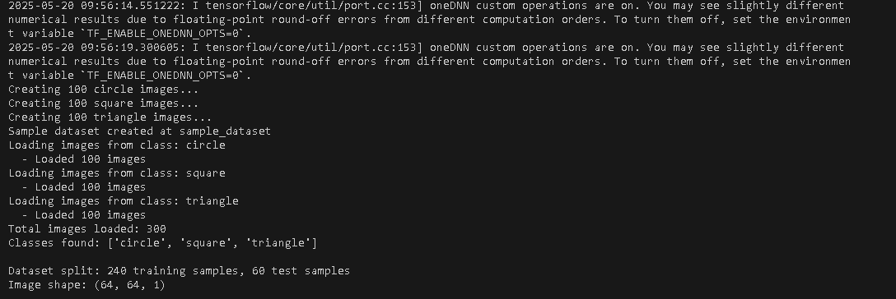
RESULTSOF TENSOR FLOW
REUSLTS

Slide 14
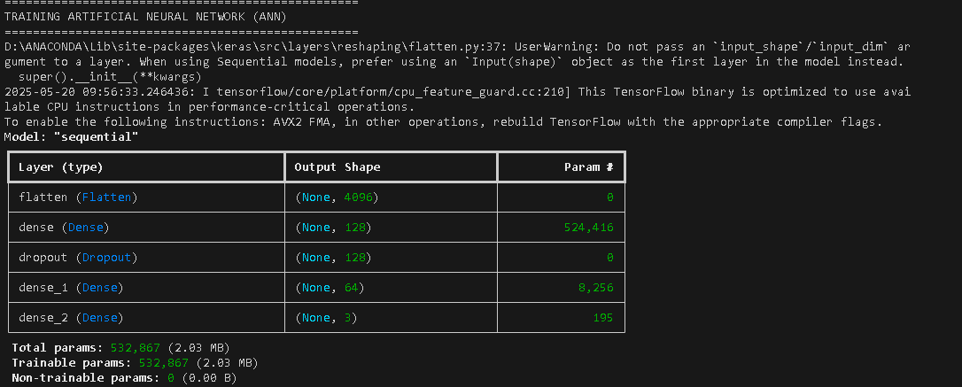
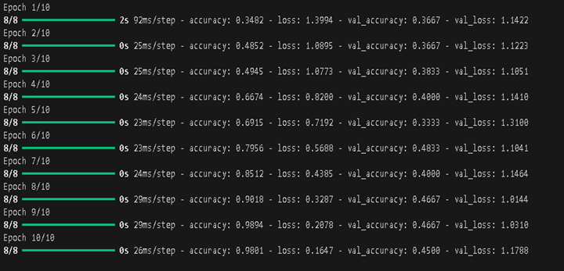
RESULTS
RESULTS OF TRAINING ARTIFICAL NEURAL NETWORK

Slide 15
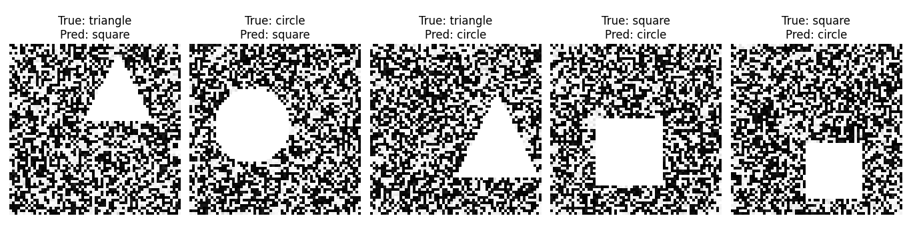
RESULTS
CLASSIFICATION OF MEDICAL DIAGNOSIS OF SHAPES OF ANN EVALUATION

Slide 16
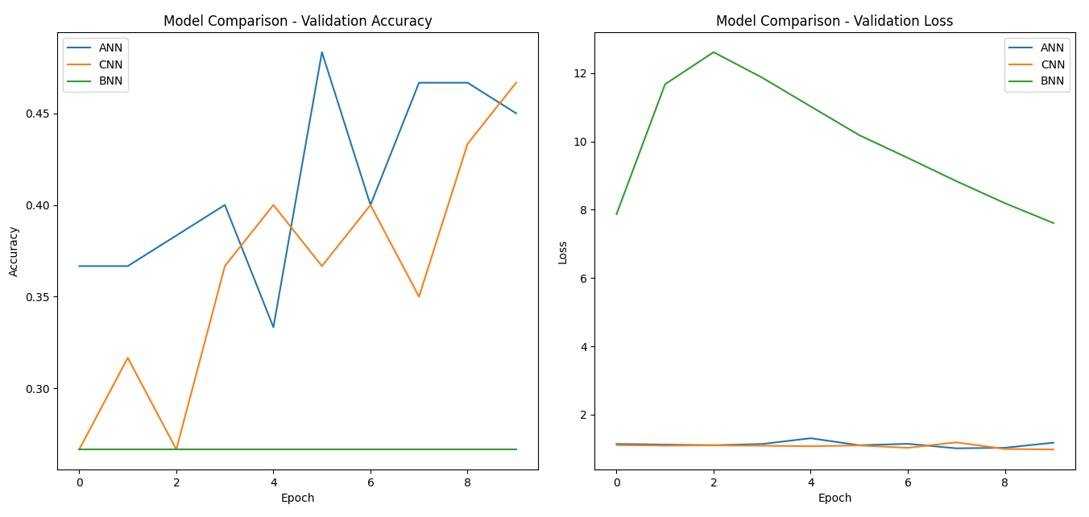
RESULTS
MODEL COMPARSION OF ANN,CNN AND BNN MODEL

Slide 17
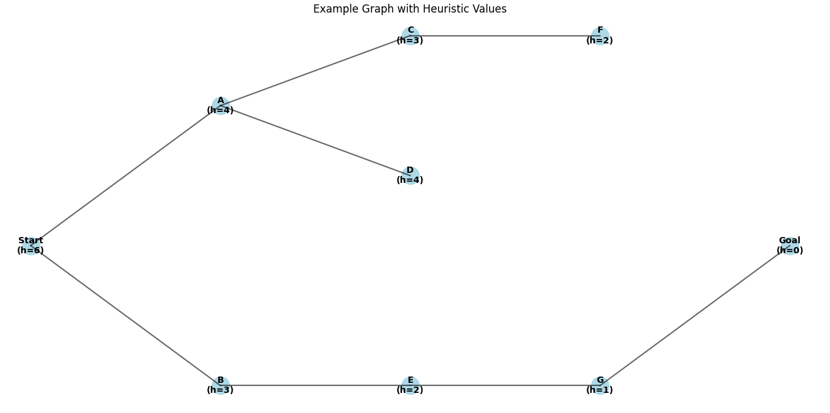
RESULTS
GRAPH OF BEAM SEARCH ALGORTHIM

Slide 18
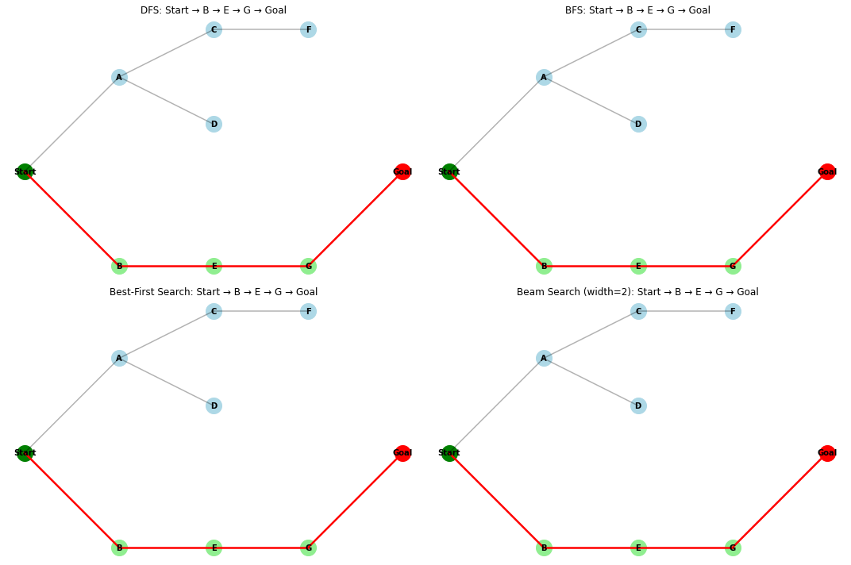
RESULTS
GRPAH OF BEST-FIRST SEARCH ALGORTHIM

Slide 19
CONCLUSION
AI for medical diagnosis has the potential to revolutionize healthcare by providing accurate and efficient diagnosis of diseases
AI has demonstrated exceptional accuracy in identifying cancer and other diseases
Advanced models for highly accurate identification of mammograms and skin cancer in dermatological images
Obstacles: difficulty in understanding AI decisions, concerns about data privacy, and the requirement for large, high-quality datasets

Slide 20
REFERNECES
[1] X. Wang, Y. Peng, L. Lu, Z. Lu, M. Bagheri, and R. M. Summers, "ChestX-ray8: Hospital-scale chest X-ray database and benchmarks on weakly-supervised classification and localization of common thorax diseases," Proc. IEEE Conf. Comput. Vis. Pattern Recognit., 2017, pp. 3462–3471.
[2] P. Rajpurkar, J. Irvin, K. Zhu, et al., "CheXNet: Radiologist-level pneumonia detection on chest X-rays with deep learning," arXiv preprint arXiv:1711.05225, 2017.
[3] A. Esteva, B. Kuprel, R. A. Novoa, et al., "Dermatologist-level classification of skin cancer with deep neural networks," Nature, vol. 542, no. 7639, pp. 115–118, 2017.
[4] D. S. Kermany, M. Goldbaum, W. Cai, et al., "Identifying medical diagnoses and treatable diseases by image-based deep learning," Cell, vol. 172, no. 5, pp. 1122–1131, 2018.
[5] E. Topol, Deep Medicine: How Artificial Intelligence Can Make Healthcare Human Again, Basic Books, 2019.
[6] J. Amann, A. Blasimme, E. Vayena, D. Frey, and V. I. Madai, "Explainability for artificial intelligence in healthcare: a multidisciplinary perspective," BMC Med. Inform. Decis. Mak., vol. 20, 2020.

Slide 21


